Slide 1


Slide 2

Energy and Environmental Revolution of Buildings
Alice Monty
The UK Experience (Keepmoat Regeneration)

Slide 3
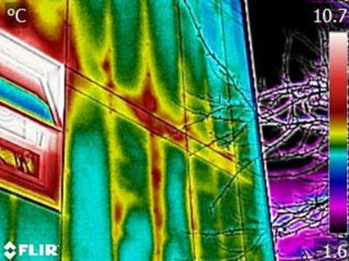
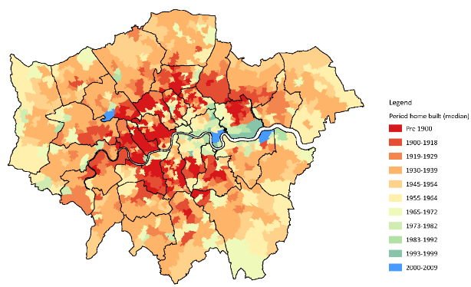
UK London and South Housing Market Challenges
Large volume of poorly insulated and inefficient properties
High energy bills and fuel poverty
Housing Providers require low-cost solutions
Housing shortage
Strict energy efficiency requirements for new builds
Post Grenfell fire issues

Slide 4
UK London and South Housing Market Challenges
Challenges | Keepmoat’s proposed Solutions
Large volume of poorly insulated, inefficient properties | Decentralised Renewable Energy Thermal Insulation Schemes
Housing Providers require low-cost solutions | Government funding and grants EnergieSprong
High energy bills and fuel poverty | Fuel Poverty Service
Housing shortage | Rooftop Extensions and modular housing
Strict energy efficiency requirements for new builds | Design stage assistance to comply with energy standards
Post Grenfell fire issues | Providing client assistance on fire safety check services and fire safety works

Slide 5
Keepmoat’s Energy Capabilities: Decentralised energy
London Borough of Camden
£30m of estate wide district heating upgrades
14 tower blocks
854 properties
Saved over 78,000 tonnes of carbon
Reduced energy consumption by over 7MW

Slide 6
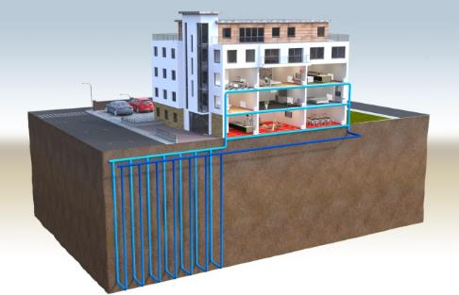
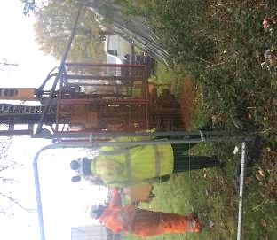
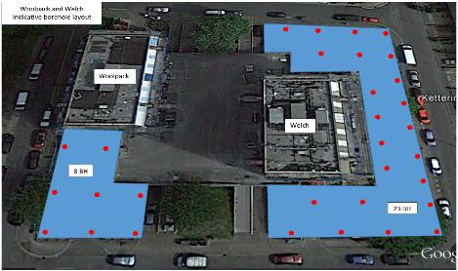
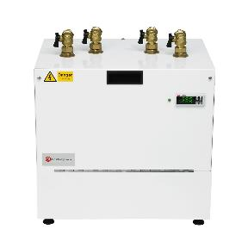
Enfield Council
Largest GSHP in UK
Starts November 2017 – 48 weeks
8 blocks – 402 flats
Ground source heat pumps

Slide 7
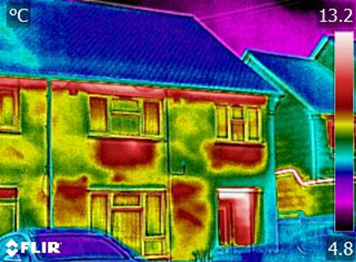
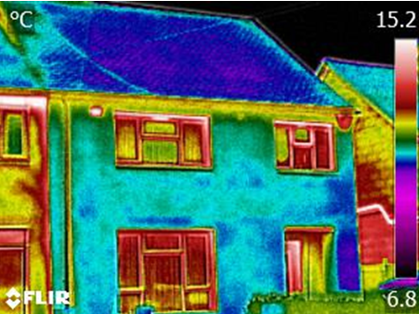
Keepmoat Regeneration’s Energy Capabilities : Thermal Insulation Schemes

Slide 8
Keepmoat Regeneration’s Energy Capabilities: Government funding schemes
Renewable Heat Incentive
ECO Funding
Feed-In Tariffs

Slide 9
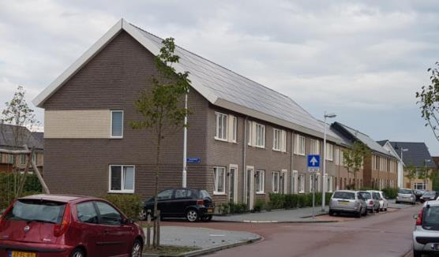
Keepmoat Regeneration’s Energy Capabilities : EnergieSprong

Slide 10
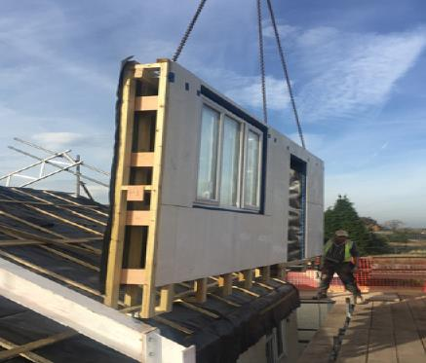
Keepmoat’s Energy Capabilities: EnergieSprong
Offsite Solution
30-year performance guarantee
PassivHaus standards
Fast build
Limited disturbance
Created healthier, more comfortable homes to live in
A new-look home
Increased asset value

Slide 11
Keepmoat’s Energy Capabilities: EnergieSprong
Notes:
Nigel Government and LA policy has a massive spotlight on fuel poverty and Keepmoat’s activities in this area are significant.
All our clients want to tackle fuel poverty across the portfolios but very few schemes have succeeded. Our service in Oldham is now renowned for the scale of impact (helping over 1,200 people a year) and the health cost savings that it is bringing (reducing Emergency Admissions by 32%).
Greater Manchester are due to roll this service out across all 10 local authorities and we believe that this model can be taken to other partnerships of Local Authorities and NHS CCGs.
Refer to the clients we work with
This links directly into the ENGIE ‘Local Energy Offers’ - supporting Council strategic ambitions

Slide 12
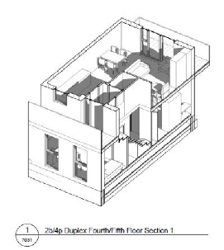
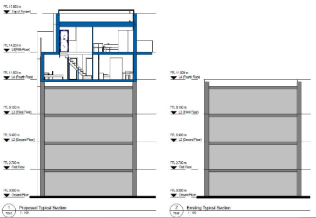


Keepmoat’s Energy Capabilities: Innovative Housing Solutions
Rooftop Extensions
  - Tackling shortage of urban space for home-building
  - Tackling housing shortage
  - Energy Efficient Homes
Modular Housing
  - Offsite Solution
  Reduced programme times
  Design flexibility

Slide 13
Grazie

